Slide 1
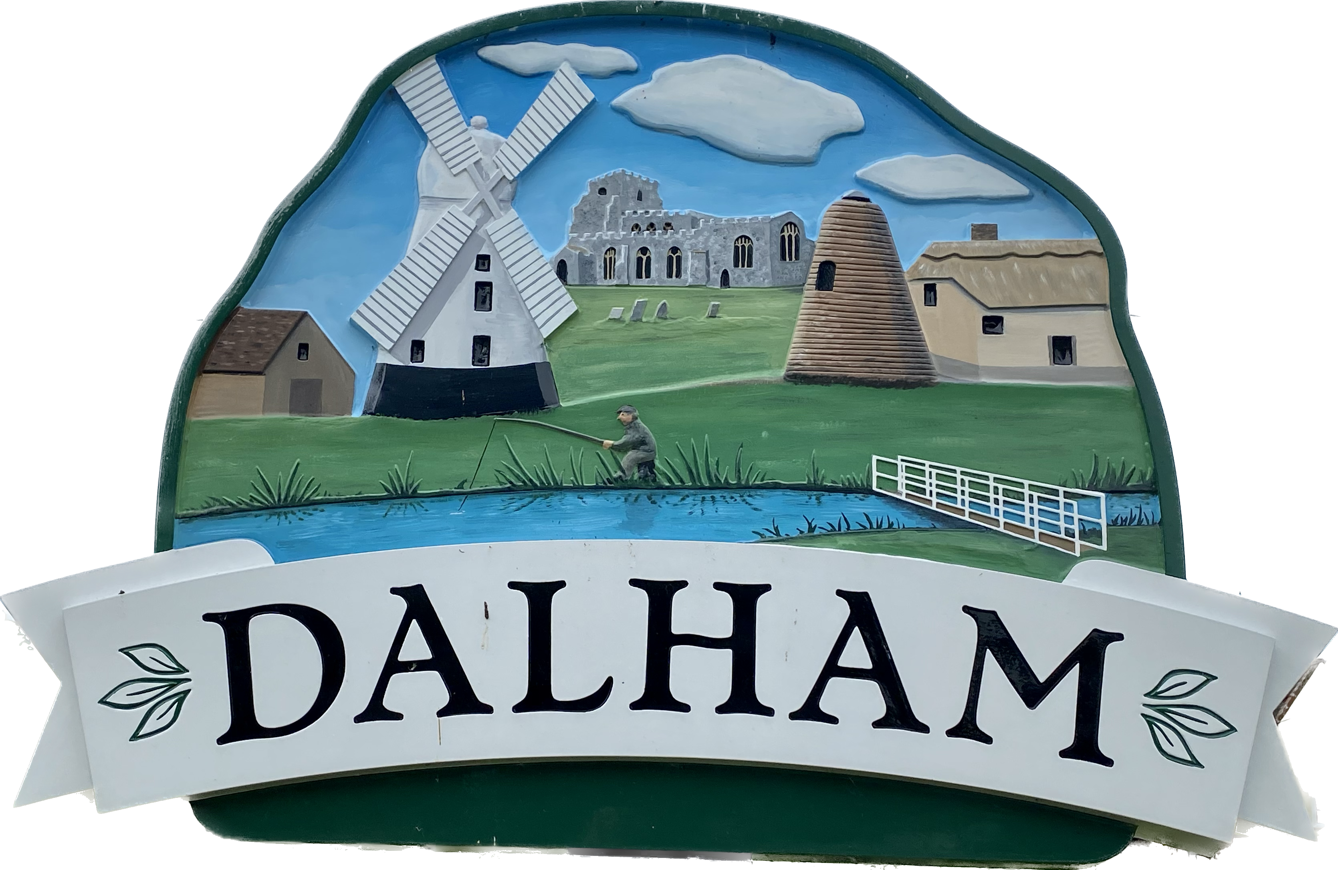
Dalham Parish Council
Website content and recommendations
August 2023

Slide 2
Executive summary
The primary purpose of the Parish Council website is to enable the Parish Council to meet its legislative duties and to communicate required information to the residents of the Parish. This includes meeting agenda and minutes, directory of council members, and other relevant Parish Council documents such as policy and finance documents.
In addition, the website provides a general source of local information and links to helpful resources and contacts.
Generally, there is an opportunity to consolidate content so that we focus on the business of the Council, rather than trying to replicate community directories and content pages.
Key recommendations
Change primary navigation and adjust site content to reduce the number of high-level menus from 7 to 5
Provide clearer markers to information about the Parish Council, The Village, and links through to local resources and contacts
Remove information such as COVID Info which is no longer required
Add more detail about the function and business of the Parish Council, and details about the Councillors
Leverage links to resources and commentary on dalham.com, rather than trying to replicate ourselves

Slide 3
Website background and purpose
The Dalham Parish Council website is located at https://dalham.onesuffolk.net .
The website is hosted by One Suffolk, a low cost website provider and community portal for organisations and businesses in and around Suffolk. The Parish Council pays £60 inc. VAT per year for One Suffolk to host the website and to make use of the Parish Council page templates and functionality.
The primary purpose of the Parish Council website is to enable the Parish Council to meet its legislative duties and to communicate required information to the residents of the Parish. This includes meeting agenda and minutes, directory of council members, and other relevant Parish Council documents such as policy and finance documents.
In addition, the website provides a general source of local information and links to helpful resources and contacts.
The website is administered by the Clerk.

Slide 4
Home page Currently

Slide 5
Navigation and site content Currently
Home
Parish Council
COVID Info
The Village
Contacts
Local Info
Flood Info
What’s New
About the Parish Council
Meetings
Annual Parish Meetings
Policy documents
Finance
Planning
Newsletters
Quiet Lanes Project
Gallery
Dalham Malt Kiln
Member of Parliament
County Councillor
District Councillor
Suffolk Police
West Suffolk Council
Suffolk County Council
Reporting a Highways or Public Rights of Way Problem
Grass cutting
Walks near Dalham and beyond
Police Info
Newmarket Day Centre
Befriending network to help reduce loneliness
Arthritis Action Groups
How to report flooding
Latest news

Slide 6
Navigation and site content Observations
Website contains a mix of content around Parish Council business, with information and resources that may be relevant to villagers.
Not clear from reading the website what the Parish Council is responsible for and what function it plays in the community. It would be helpful to give a better overview of what the Parish Council does, it’s role in areas like planning (detail is tucked away), and things it’s not responsible for, like enforcing speeding in the village (About the Parish Council).
Not clear why certain resources and links to services are included (and others not). It would be helpful to review what’s included in Local Info to remove those items better placed elsewhere.
Opportunity to reduce / consolidate content so that we focus on the business of the Council, rather than trying to replicate community directories and content pages, alongside more general information available through dalham.com (which is operated by the Village Hall).
Newsletters have not been published since Autumn 2020. We could consider using the Latest News section as the entry point to the newsletters.
We’ll need to look at website accessibility and our obligations, alongside our statements regarding compliance.

Slide 7
Primary navigation and site content Proposal for discussion
Home
Parish Council
The Village
Contacts
Resources
News
About the Parish Council
Parish Councillors
Regular meetings
Annual meetings
Policy documents
Finance documents
About Dalham
About Dunstall Green
Alms Houses
Affleck Arms
Malt Kiln
St Mary’s Church
Village Hall
Walks
Windmill
Gallery
Parish Councillors
Member of Parliament
County Councillor
District Councillor
Suffolk County Council
West Suffolk Council
Community groups
Emergency plan
Flooding
Mobile libraries
Planning
Police Information
Report a Highways Issue
Verge cutting
Latest news
Newsletters
KEY
Red – new page or label update
Blue – hyperlink to content on another website

